Slide 1
Two-way ANOVA—Able-bodied subject data（three）

Slide 2
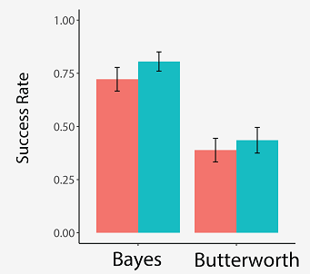

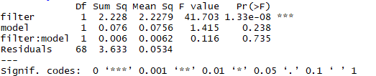
Success rate——Able-bodied subjects
filter—F(1,68)=41.703, P<0.001
model—F(1,68)=1.415, P=0.238
filter: model —F(1,68)=0.116, P=0.735

Slide 3
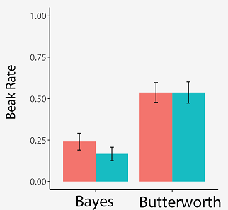
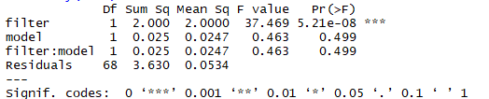
Break rate——Able-bodied subjects
filter—F(1,68)=37.469, P<0.001
model—F(1,68)=0.463, P=0.499
filter: model —F(1,68)=0.463, P=0.499

Slide 4
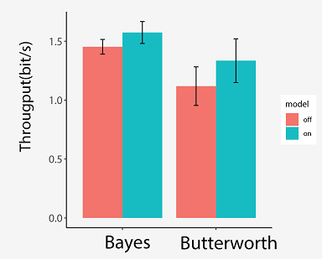
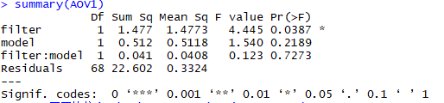
Throughput——Able-bodied subjects
filter—F(1,68)=4.445, P<0.05
model—F(1,68)=1.540, P=0.2189
filter: model —F(1,68)=0.123, P=0.7273

